Slide 1


Bank Management System
Shivam Gehani
Nabeel Ahmed

Slide 2
PROBLEM STATEMENT
01
02
03
Manual System
No Backup Planning
Error Possibility

Slide 3
PROJECT GOALS AND OBJECTIVES
01
02
03
04
05
Admin Login
Account Creation
D/W/C Money
Back-up Record
Debit/Credit

Slide 4
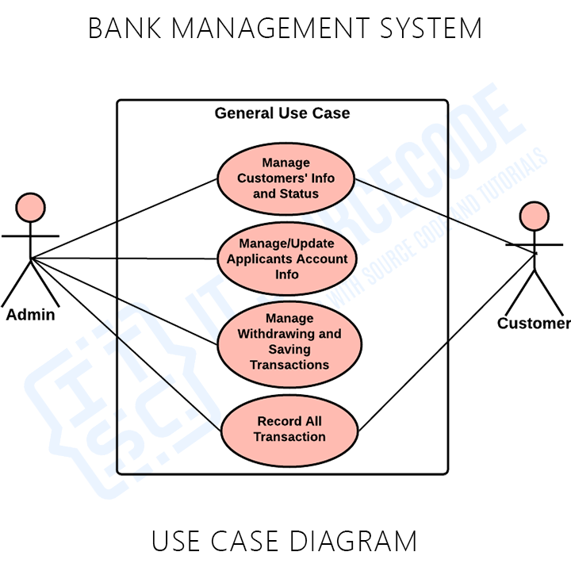
PROPOSED METHODOLOGY

Slide 5
MAJOR OUTCOMES
01
02
03
Digital Account
Backup Planning
More Precise and Accurate

Slide 6
PROJECT IMPLEMENTATION
01
02
03
GUI by Coding
MS Access (Database)
Exception Handling

Slide 7
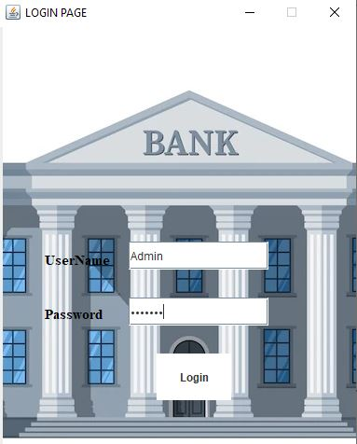

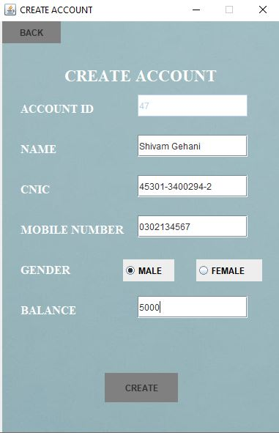
SCREENSHOTS

Slide 8
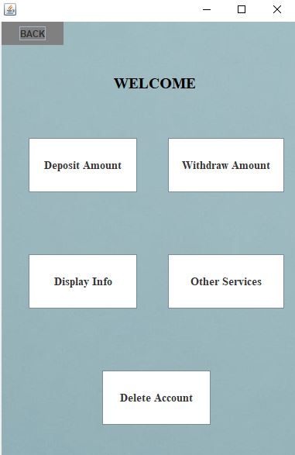
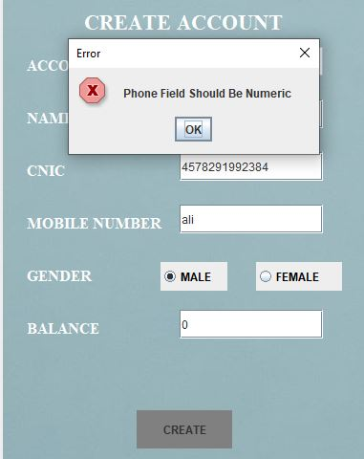
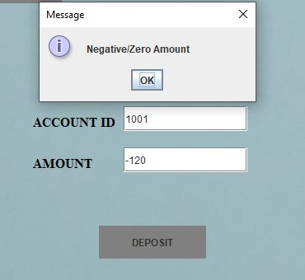
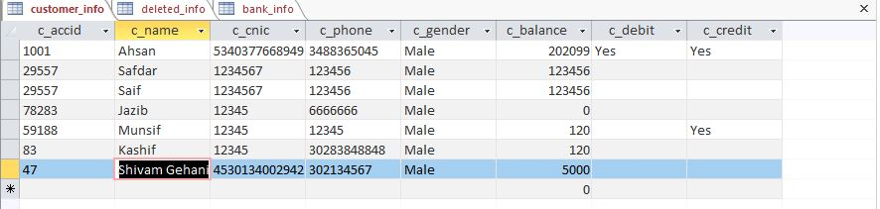
SCREENSHOTS

Slide 9
—STEVE JOBS
“Everybody in this country should learn how to program because it teaches you how to think.”

Slide 10
THANKS!

